Slide 1
Optimization in Modern Power Systems
Transmission Expansion Planning Under Uncertainty
46750 – Optimization in Modern Power Systems
Group 5 | DTU | November 2025

Slide 2
Case Introduction
The Danish Transmission System Operator (Energinet) faces a critical strategic decision: how to optimally plan transmission network expansion under increasing renewable penetration and spatially uneven load growth.
Problem: When to invest in new transmission capacity?
Context: Growing renewable energy hub at node 1, concentrated urban demand at node 2 using fossil fuels, thermal generation at node 3
Challenge: Balance investment costs against future operational benefits under uncertain futures

Slide 3
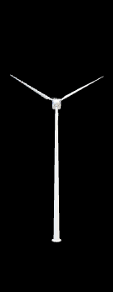
Three-Node Network Structure for Model 1
🏙️
🔥
🔨
Node 1
Node 2
Node 3
Reinforcement
RES Hub
30 DKK/MWh
500 MW capacity
80 MW demand
Urban Load - Fossil
500 DKK/MWh
150 MW capacity
400 MW demand
Biomass generation
200 DKK/MWh
250 MW capacity
100 MW demand
Node 1 – Node 2
50M DKK
0 MW - 200 MW
Line (1-2): 200 MW, Line (1-3): 150 MW, Line (2-3): 100 MW
Candidate: Reinforce (1-2)

Slide 4
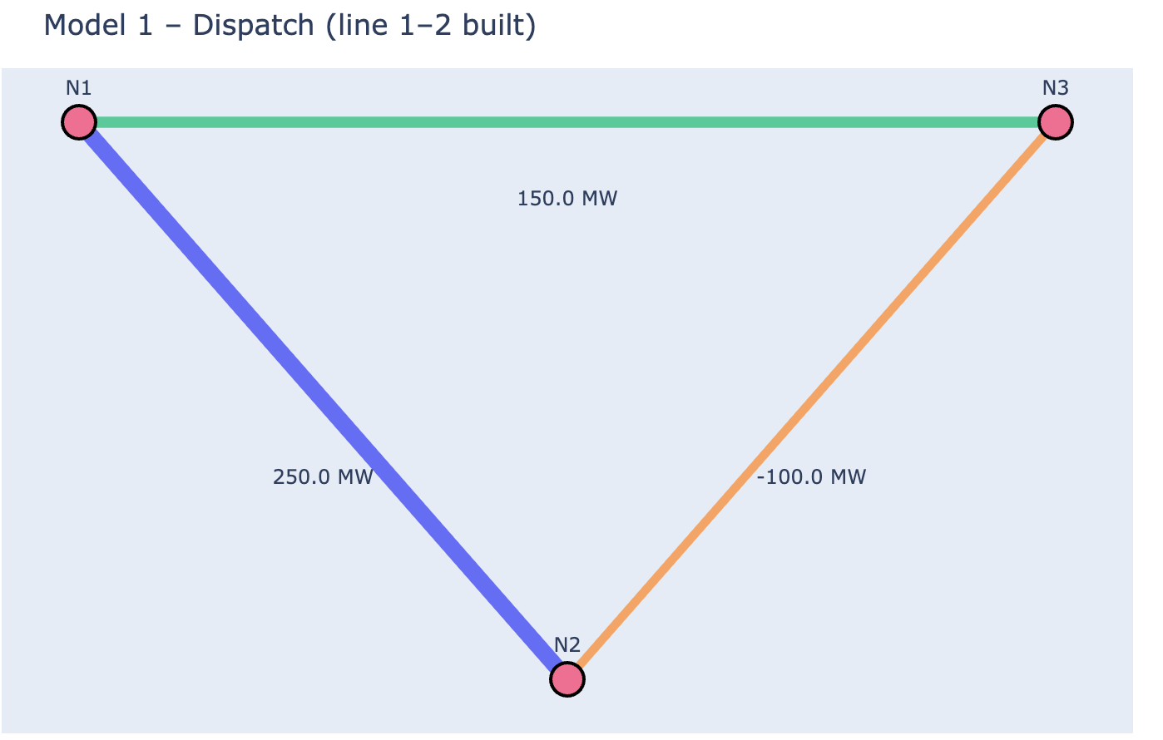
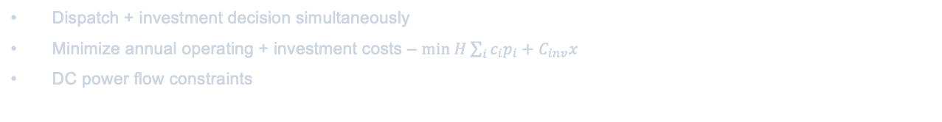

Model 1: Myopic Deterministic Expansion
Single-period optimization under perfect foresight for 2050.
H = 8760 hours
$c_{i}$ is marginal generation cost at node i
$p_{i}$ is generation dispatch at node i
$C_{inv}$ is annualized investment cost for line 1-2 reinforcement
x∈{0,1} is binary: build reinforcement (1=yes)
Dispatch + investment decision simultaneously
Minimize annual operating + investment costs – $min H\sum_{i}{c_{i}p_{i}+C_{inv}x}$
DC power flow constraints
Key Finding:
Reinforces line (1-2) because cost of congestion justifies investment
Investment Decision
x = 1 (BUILD)
Annual Cost
26.1M DKK
Node 1 Output
480 MW (96%)

Slide 5
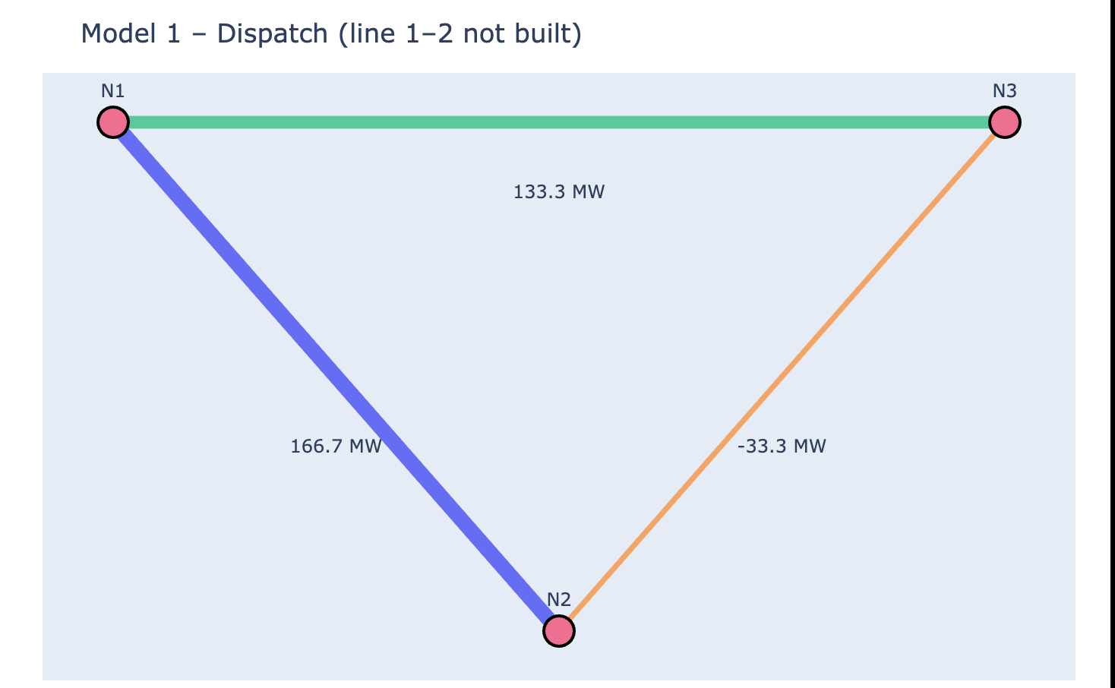
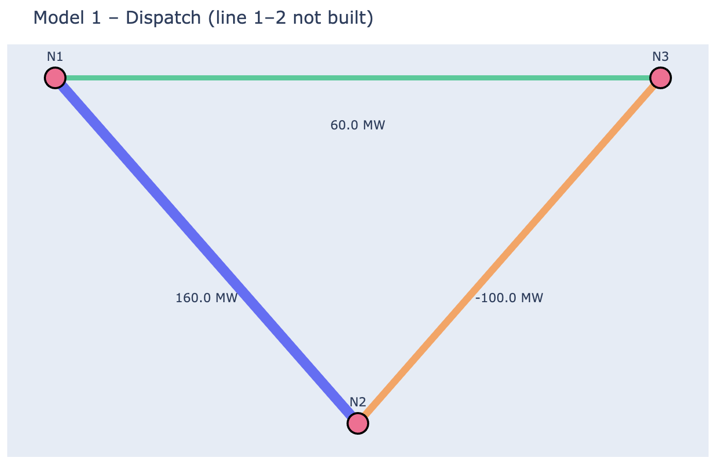
Model 1: Sensitivity Experiments
Experiment 1 - Reduced Urban Demand
d₂ = 200 MW (−50%)
Result: x = 0 (NO investment)
Lower demand eliminates cost of congestion
Experiment 2 - Reduced RES Capacity
G₁ = 300 MW (−40%)
Result: x = 0 (NO investment)
Limited RES removes need for expansion

Slide 6
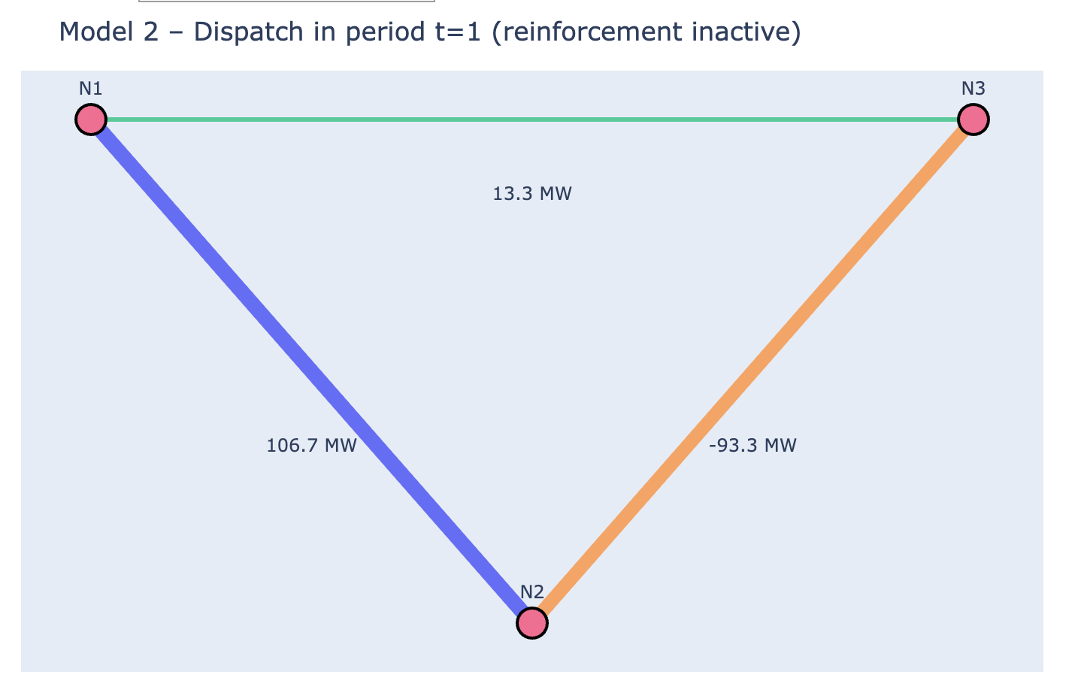
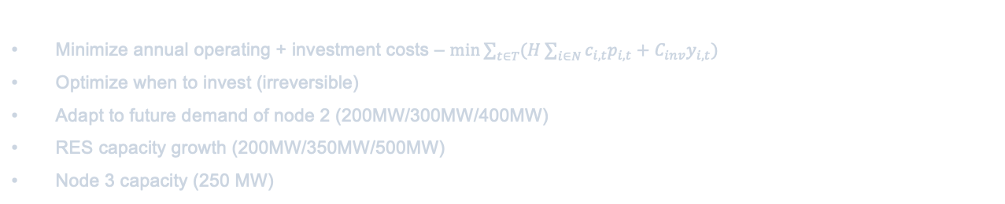

Model 2: Intertemporal / Anticipative Expansion
Multi-period optimization with investment timing (2030, 2040, 2050).
T is periods {1,2,3}
$y_{i,t}$∈{0,1}: invest in period t
$c_{i,t}$ is marginal generation cost at node i
$p_{i,t}$ is generation dispatch at node i
N = number of node
Minimize annual operating + investment costs – $min\sum_{t∈T}{(H\sum_{i∈N}{c_{i,t}p_{i,t}+C_{inv}y_{i,t})}}$
Optimize when to invest (irreversible)
Adapt to future demand of node 2 (200MW/300MW/400MW)
RES capacity growth (200MW/350MW/500MW)
Node 3 capacity (250 MW)
Baseline Solution:
Invest in period 2 (2040) to balance early costs vs. future benefits
Investment Timing
t = 2 (2040)
Total NPV Cost
116M DKK
Avg Annual Cost
~39M DKK/yr

Slide 7
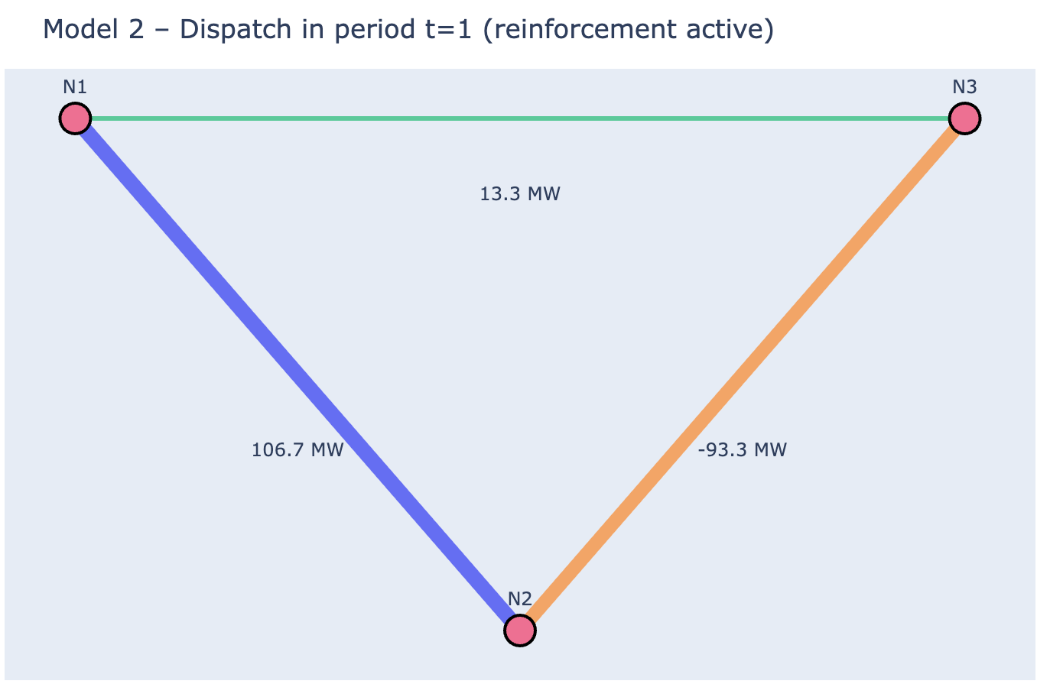
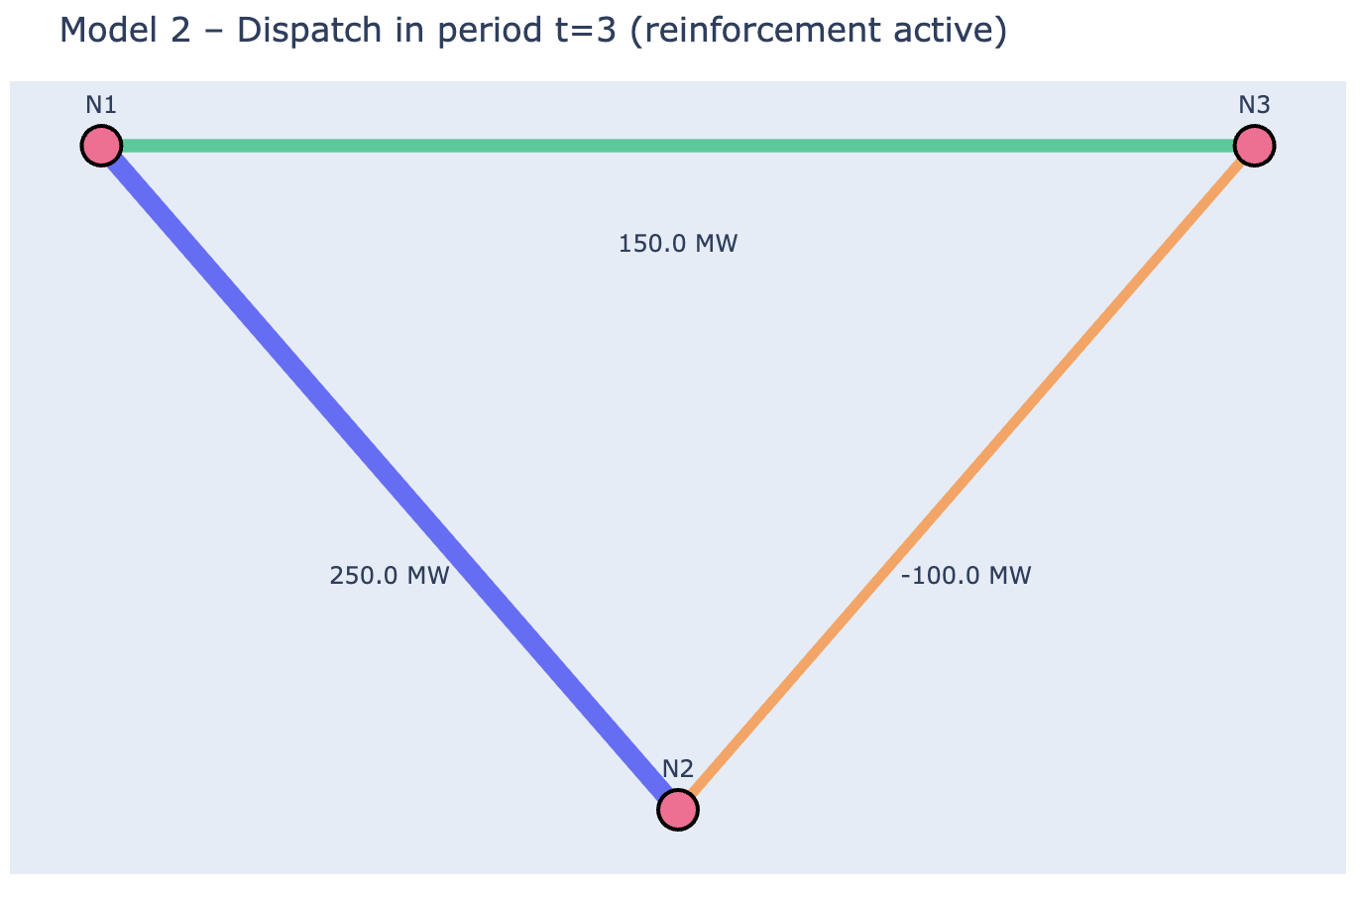
Model 2: Investment Timing Scenarios
Fossil Phase-out
Thermal retirement over time
$G_{2}$: 150 → 50 MW
Result: Invest in t = 1
Early investment needed as thermal capacity declines
Late RES Transition
RES build-out delayed to t=3
G₁: 100 MW for t=1,2 and 600 MW for t=3
Result: Invest in t = 3
Postpone investment until RES boom arrives

Slide 8
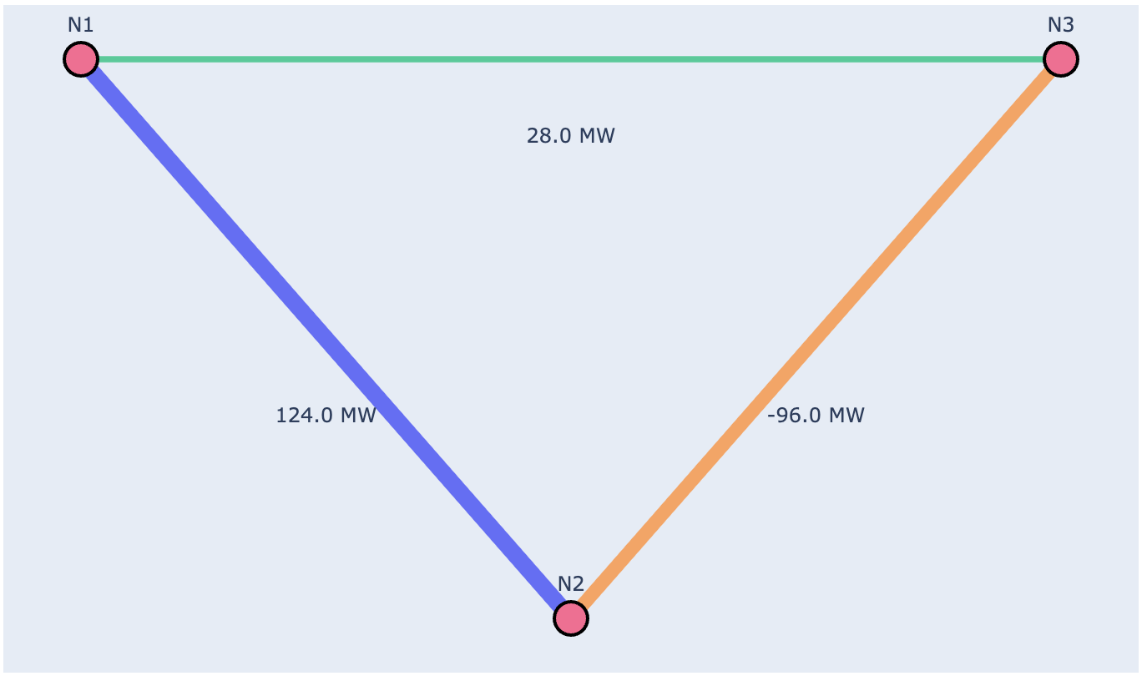
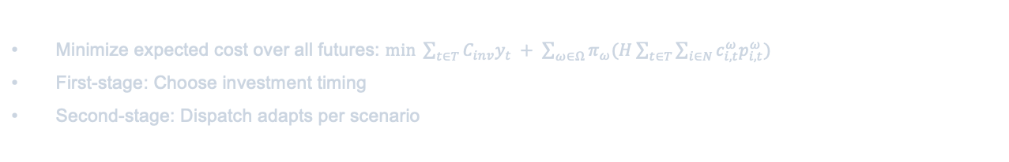

Model 3: Two-Stage Stochastic Planning
Robust investment under uncertainty with scenario-dependent dispatch.
Minimize expected cost over all futures: $min \sum_{t∈T}{C_{inv}y_{t} + \sum_{ω∈Ω}{π_{ω}(H\sum_{t∈T}{\sum_{i∈N}{c_{i,t}^{ω}p_{i,t}^{ω}}})}}$
First-stage: Choose investment timing
Second-stage: Dispatch adapts per scenario
Ω = {high, base, low}}: uncertainty scenarios
$c_{i,t}^{ω}$: scenario-specific marginal cost
$p_{i,t}^{ω}$: scenario-specific generation
$π_{ω}$: probability of scenario ω
Three Scenarios:
High-demand/high-RES | Baseline | Low-demand/low-RES
Robust Timing
t = 1
Hedges Risk
vs Deterministic
Value of three scenarios
± % of cost over time, varying high, base, and low scenarios

Slide 9
Key Findings & Strategic Recommendations
Investment Justification: Line (1-2) expansion is economically robust across deterministic and stochastic scenarios, provided RES buildout and urban demand materialize as planned.
Timing is Critical: Timing of line (1-2) expansion varies depending on scenarios proposed by experiments
Sensitivity: Investment decision highly sensitive to demand growth and RES availability. Delayed RES transition favors postponement, due to prices of generation at node 2 and 3
Limitations & Future Work: CAPEX too low (always worth hedging risk), fixed prices unrealistic (does not account for true electricity demands over 24 hour period/price change), no ramp up or shutdown at nodes, investigate CO2 emission constraint and implement true 2050 EU specific goals, investment in different lines

Slide 10
Limitations and Future Work
CAPEX too low (always worth hedging risk)
Fixed prices unrealistic (does not account for true electricity demands over 24 hour period/price change)
No ramp up or shutdown at nodes
Investigate CO2 emission constraint and implement true 2050 EU specific goals
Investment in different lines reinforcement
No BESS

Slide 11
Thank You!
Questions & Discussion
Optimization in Modern Power Systems | DTU | 2025

